Slide 1
Large-Scale Automatic Reconstruction of Neuronal Processes from Electron Microscopy Images
By Verena Kaynig et al.
Presentation by Chris Micek

Slide 2
Summary
The field of microscopy has progressed to such an extent that automated sample preparation and acquisition of nanoscale images does not pose much of a problem.
The main bottleneck is in reconstructing neuronal processes (aka features) in 3D using images that are segmented.
The authors introduce a pipeline that automates this to a reasonable degree, as well as a semi-automated proofreading tool to make this process more accurate.

Slide 3
Opportunity
Now lots of nanoscale EM data available to analyze.
Looking at brain circuits at the scale of individual neurons may offer more insight into the underlying mechanisms of certain brain disorders.
However…

Slide 4
Challenge
The size of the data set is massive (Think ~1,000 TB +)
Because of this, manual reconstruction is not feasible – it would take way too long.
The solution is to automate as much of this process as possible with a new pipeline.

Slide 5
Action (the pipeline)
Random forest classifier uses manually annotated training data to detect cell membranes in images.
Multiple region segmentation hypotheses are generated per section.
These segments are grouped in 3 dimensions using segmentation fusion.
Semi-automatic proofreading to create 3D reconstruction

Slide 6
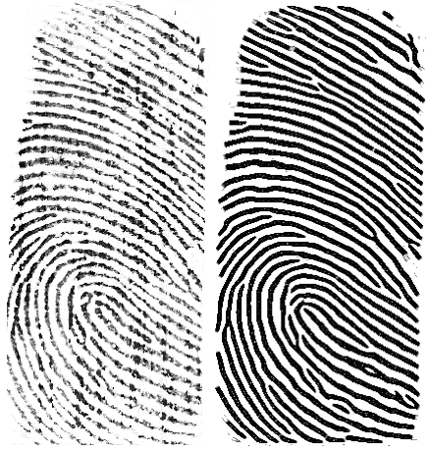
Action (under the hood)
Classifier makes multiple passes, with output annotated for correction – improves per pass
Conditional Random Field (CRF) used for anisotropic smoothing (image → math stuff → smoother image), because easier to segment accurately
3D segmentation – find regions that are “most similar” across adjacent images

Slide 7
Action (Mojo proofreading tool)
Created a tool to minimize user input while correcting split and merge errors.
Easy to use: Click source and target to correct split, scribble out regions to correct improper merge.
To speed up, pre-loads windows of select sizes for zooming.

Slide 8
Errors?

Slide 9
Resolution
Notes:
Top left: Evaluation of segmentation fusion compared to agglomerative clustering and Sopnet. As a baseline we provide the variation of information score for ungrouped data. Lower scores correspond to better region groupings.
Right: Roughly 70% accurate, but large and small regions have a greater error rate.
Also works in parallel!

Slide 10
Future Work
Improve accuracy – tweak segmentation algorithm
Improve speed – reduce MATLAB dependencies, general optimization
Make proofreading easier – bring Mojo to the web

Slide 11
Discussion
Pros
Much faster than manual reconstruction
Reasonably accurate
Easy to use
Cons
Still makes mistakes
Still requires a human to operate
Mojo errors when running in parallel

